Slide 1

The city of a thousand of lights
An epic first experience into the capital city of Kenya, NAIROBI

Slide 2
The recapture
Have you ever dreamed of travelling to a different place? A place with so much noises, growth,industries,beautiful skyscrapers?
Well that’s the best thing that ever happened to me as a person when I first took a glimpse of Nairobi in reality like my whole mind and body was in Nairobi as opposed to the latter only hearing about the city on the mouths of blabbers back in our village.
“In Nairobi everyone is busy, everyone is walking fast and in a hurry like they are going to miss the train! "is all my cousin used to say when he visited us for Christmas celebrations.

Slide 3
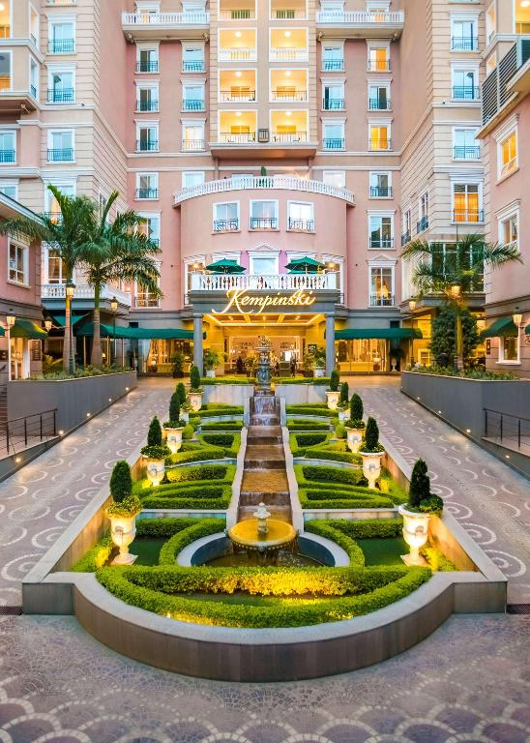
Beautiful sceneries
Nairobi has the most beautiful tall buildings .I actually reached Nairobi at night and the first indication was the prestigious westlands area where big and prestigious companies and hotels like villa Rosa kempinski are located.
The most astonishing thing I saw that night was actually a casino. A big betting building that I only knew existed in movies! Nairobi is really beautiful!

Slide 4
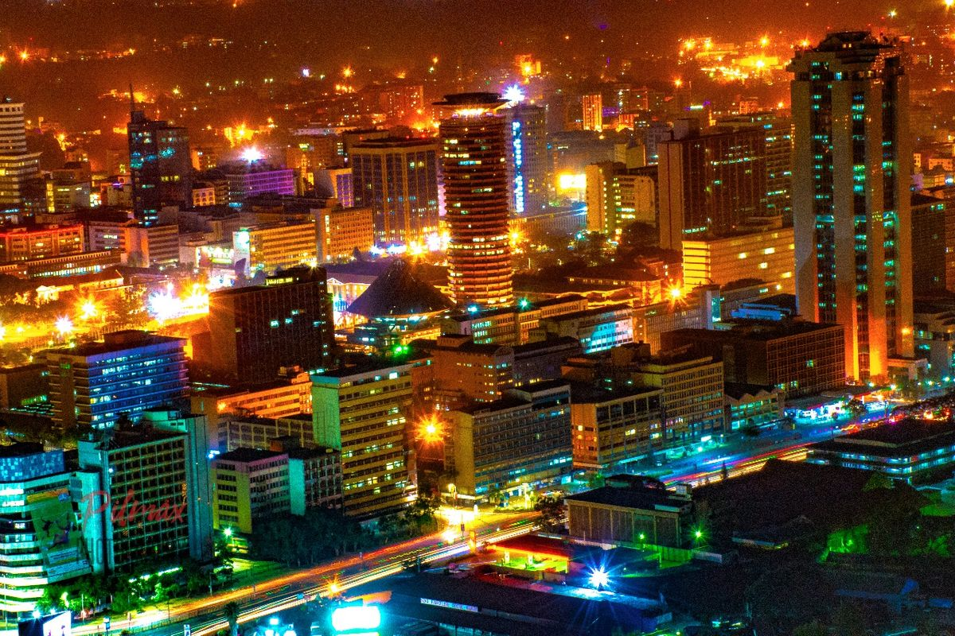
The city lights

Slide 5
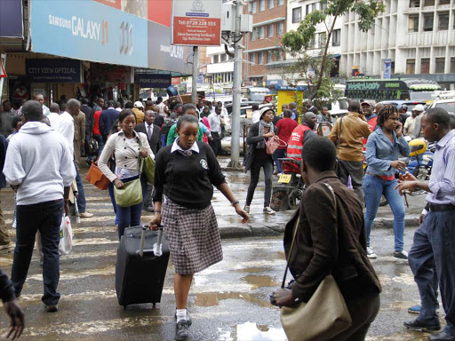
Boatload
The most amusing thing about Nairobi is the CBD(central business district)
The fact that there's no difference of day and night and the fact that people work like termites compared to my village back in siaya county where by 8 o'clock people would be in their houses and it would be as dark as the yawning grave..
The most astounding thing was the constellation and boatload of people who seemed to be walking like in a race its like they were being followed by a plague.Nairobi!Nairobi! How you amaze me!

Slide 6
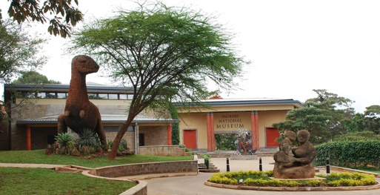
Rich heritage
The fact that Nairobi is not only the Centre of trade and Centre of urbanization, but also an area embodied with so much heritage such as the national museums where artefacts are placed and has one of the largest national park in East Africa the Nairobi national park.Nairobi!Nairobi! Am still yet to discover more about you!

